Slide 1
Discourse Analisys 1- Language in Use
D.A. deals with language in context, linking the text/utterance with its social situation.
1960s and 1970s out of work in different disciplines: linguistics, psychology, antropology, sociology.
Contribution of semiotics and the French structuralists approach to the study of narrative.
Dell Hymes: speech in social settings (1964);
Language as social action: speech-act theory, conversational maxims (Austin, 1962; Searle, 1969, Grice, 1975), pragmatics, i.e. the study of meaning in context (Levinson, 1983; Leech, 1983).

Slide 2
Discourse Analisys 1- Language in Use
Every day we encounter or take part in a wide range of different types of spoken interactions….
Each situation has its own conventions and formulae, different role relationships, different purposes and different settings.
Discourse analysis is interested in all the above creating a fundamental distinction between:
LANGUAGE FORMS (grammatical, lexical, phonological) and
DISCOURSE FUNCTIONS (what we do with the language)

Slide 3
Discourse Analisys 1- Language in Use
D.A. is interested in the relationship between discourse forms (grammatical, lexical, phonological) and discourse functions.
Forms are the RAW materials which enable students to use language FUNCTIONALLY.
British D.A. was greatly influenced by the work of M.A.K Halliday’s functional approach to language (1973). His framework emphasizes the social functions of language and the thematic and informational structure of speech and writing

Slide 4
A text is “language that is functional”, that is to say …….
“language that is doing some job in some context” (Halliday in Halliday & Hasan, 1985/ 1989: 10).
In this functional perspective, a text is therefore always seen as being strictly related to:
1- its Context of Situation, which is defined as the immediate social and situational environment in which a text is being realized,
2- the Context of Culture which is the ‘outer’, more external, or ‘higher-order’ context surrounding both the text and its specific Context of Situation.
D.A. is interested in the relationship between discourse forms (grammatical, lexical, phonological) and discourse functions.
Forms are the RAW materials which enable students to use language FUNCTIONALLY.

Slide 5
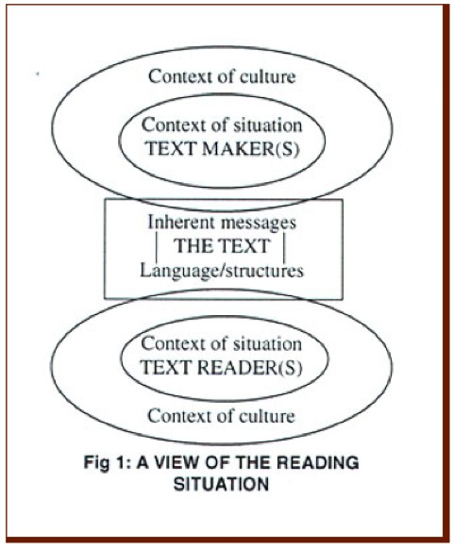

Slide 6
A text, therefore, is basically made of meanings that, in order to be communicated, need to be encoded and expressed through a system of graphic, phonic or visual signs. As a thing in itself, it is a consistent semantic unit.

Slide 7
A text is both an object, a product of its environment, of its Context of Situation and Context of Culture, and an instance of social meaning in a specific situation.
The relation between text and context is a systematic and dynamic one:
- on one hand, a text is the result of the context in which it is being realized and where language is being shaped to function purposefully;
- on the other hand, a context is then realized in turn by the text: through a text a context is being created.
(Halliday in Halliday & Hasan, 1985/ 1989: 10-11).

Slide 8
Context of Situation
Context of Situation is seen as being comprised of 3 components, or values, or dimension of variation:
Field, Tenor and Mode, or, respectively:
FIELD: what is going on?
TENOR: who is taking part?
MODE: how are the meanings being exchanged?

Slide 9
Field, Tenor and Mode.
Field – the nature of the ongoing social speech event and its subject matter, what is being spoken about;
Tenor – the human participants in the interaction and the relationship between them, involving their status and discourse roles, as well as the attitude they take towards the subject matter and their interlocutors,
Mode – the way that language is functioning in the interaction, which involves a series of features such as the degree to which the process of interaction is shared by the interlocutors, its ‘channel’, its ‘medium’ etc.
(see Halliday & Hasan, 1985/ 1989: 12)

Slide 10
Discourse Analisys
Semantic meaning (without the context) serves a pragmatic purpose [pragmatics: what people mean]
Utterance (enunciato). Linguists sometimes use utterance to simply refer to a unit of speech under study. The corresponding unit in written language is text.
Importance of context and shared knowledge.
Overheard during a flight:
“I think we should keep him somewhere safe where he doesn’t hurt anyone”;

Slide 11
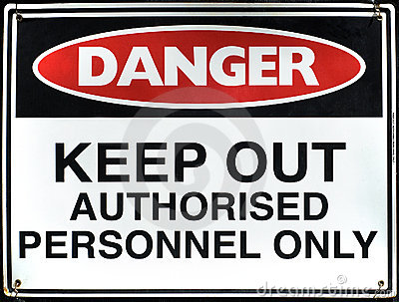
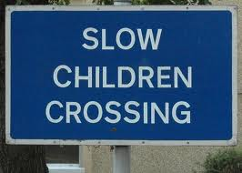
Discourse Analisys 1- Language in Use
Language as communicative purpose (function)
Text: actual use, not an abstract unit of language (its purpose or function, something to act upon)
What a terms denotes vs what it refers to

Slide 12
Discourse Analisys
Slow Children Crossing
P1’s intention P2’s interpretation
mediated through mediated through
DISCOURSE DISCOURSE
P1-------------------------------------- TEXT ------------------------------------P2
speaker encoding decoding listener
writer reader
“I think we should keep him somewhere safe where he doesn’t hurt anyone”

Slide 13
Discourse Analisys Semiotics (Barthes)
Sign = Signifier + Signified
SIGNIFIER = physical representation of a thing or of a concept. It is the EXPRESSION.
SIGNIFIED = meaning. It is the CONTENT.
CONTENT may be:
denotative (the ‘brain’ definition)
connotative (the ‘deeper’ meaning - see, for ex., the word ‘dog’).

Slide 14
Discourse Analisys Semiotics (Barthes)
“There is no place like home” (Dorothy, “The Wizard of Oz”).
HOME (signifier, physical representation, the expression : morphological, phonetical, lexical)
HOME (signified, the content):
Denotative content: the brain definition: home as a building, the place where I live;
Connotative content: the deeper meaning, the warmth, the atmosphere

Slide 15
Semiotics – Barthes
Objects have meanings.
Such meanings may be:
symbolic (= connotative meaning)
they have a metaphorical meaning
taxonomic (=denotative meaning)
they are included in a system where things are named and organized.
They are classified.

Slide 16
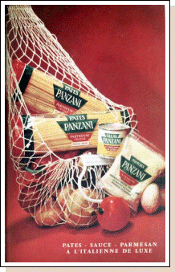
Barthes and the Rhetoric of Images

Slide 17
Semiotics – Barthes
Objects, regarded as symbols, have connotative meanings
Connotative meaning of objects can be:
Existential
Related to life but with non-human elements – market
Aesthetic
Related to design – for instance, still nature
Technological
Related to technology – i.e., when the object is useful for something else

Slide 18
Discourse Analisys 2- Communication
Knowing a language (intuitive) vs knowing about a language (explicit knowledge of encoding conventions). Linguistic competence.
But our interpretation of a discourse involves more than our linguistic competence.
Examples: He done somefing really evil and now I’m gonna kill ’im.
Her as was has gone from we. We as is will go to she.
We also consider what is appropriate in a given situation.
Norms and forms of a language
Task: ways in Italian to express disgust, from most formal to most informal.

Slide 19
Discourse Analisys 2- Communication
Proposition (we talk about something)
Reference (we make a connection with context)
Examples: His flight should be here any minute.
I’m on my way
Speech Act Theory (John Austin 1962, John Searle 1969)
Locutionary Act
Illocutionary Force
Perlocutionary Effect

Slide 20
Discourse Analisys 2- Communication
Speech Act Theory (John Austin 1962, John Searle 1969)
Locutionary Act
Illocutionary Force
Perlocutionary Effect
“Is there any salt?”
In uttering the locution "Is there any salt?" at the dinner table, one may thereby perform the distinct locutionary act of uttering the interrogatory sentence about the presence of salt, as well as the illocutionary act of requesting salt (illocutionary force of request), and the further perlocutionary effect of causing somebody to hand one the salt.

Slide 21
Discourse Analisys 2- Communication
Speech Act Theory (John Austin 1962, John Searle 1969)
Direct and Indirect Speech Acts
Example (after a dinner with friends):
Man: Let’s have coffee at our place
Wife: You’re working tomorrow……
This is an indirect speech act. The wife could have expressed the same message with a direct speech act:
Man: Let’s have coffee at our place
Wife: I am tired, I want to go to sleep

Slide 22
Discourse Analisys 2- Communication
Speech Act Theory (John Austin 1962, John Searle 1969)
Direct and Indirect Speech Acts
Direct Speech Act: grammatical form and communicative function (i.e. illocutionary force) correspond.
Indirect Speech Act: grammatical form and communicative function do not correspond.
Is there any salt??
Other examples (requests and proposals):
Would you like to meet for a coffee? - I have class….
Can you call Samantha?

Slide 23
Discourse Analisys 2- Communication
Dell Hymes’s 4 aspects of communicative competence
Hymes' original idea was that speakers of a language have to have more than grammatical competence in order to be able communicate effectively in a language; they also need to know how language is used by members of a speech community to accomplish their purposes.
Four kinds of judgement:
1- Whether (and to what degree) something is formally possible
2- Whether (and to what degree) something is feasible
3- Whether (and to what degree) something is appropriate in relation to the context in which it is used
4- Whether (and to what degree) something is actually performed

Slide 24
Discourse Analisys 2- Communication
1- possible
2- feasible
3- appropriate
4- performed
1- Something possible within a formal system is grammatical
2- (ambiguity) Visiting aunt can be boring; I met a man with a glass eye called Eric; two sisters were reunited after 8 years at a checking counter;
3- (an act of communication which is pragmatically effective as an act of communication): using language inappropriately in different contexts
4- Co-occurrence (collocations): patterning in language; idioms; proverbs: They are been being careful; too many cooks spoil the broth; by and large; by hook or by crook…..

Slide 25
Discourse Analisys Using language functionally
What we are doing with language (i.e. instructing, requesting, informing, exemplifying) is as importatnt as what we are saying.
The illocutionary force of performing an act:
Has he got news for you
This possible act of asking/requesting can become an informing speech act when/if contextualized in terms of the surrounding text and of the key feature of the situation
D.A. IS CONCERNED WITH THE RELATIONSHIP BETWEEN LANGUAGE AND THE CONTEXT OF ITS USE.

Slide 26
DA and Written Discourse
Cohesion and Coherence
«Clare loves potatoes. She was born in Ireland».
The two sentences are cohesive (Clare/she)….
The pronoun provides a link with the proper noun Clare in the 1° sentence
But they are only coherent if …………….
Cohesion is only part of coherence in reading and writing.
Cohesion is a guide to coherence, which is something created by readers in the act of reading a text.
Coherence is the feeling that a text makes sense and that it is not a jumble of sentences.

Slide 27
DA and Written Discourse
Cohesion and Coherence
«Clare loves potatoes. She was born in Ireland».
The two sentences are cohesive (Clare/she)….
The pronoun provides a link with the proper noun Clare in the 1° sentence
But they are only coherent if …………….
Cohesion is only part of coherence in reading and writing.
Cohesion is a guide to coherence, which is something created by readers in the act of reading a text.
Coherence is the feeling that a text makes sense and that it is not a jumble of sentences.

Slide 28
DA and Written Discourse
Processing a text
The surface of a text is characterized by ‘markers’ of various kinds.
For example –ed suffix is a marker of pastness.
Cohesive markers/devices (pronouns, determiners, demonstratives, other items….)create links across sentence boundaries and chain together items that are related.
However, reading a text is more complex than that.
We have to interpret it and this depends as much on what both author and reader puts/ brings into it.
The reader makes cognitive links in the text and recognizes textual patterns

Slide 29
DA and Written Discourse
Processing a text
The reader makes cognitive links in the text and recognizes textual patterns.
These patterns are manifested in functional relationships between pieces of text (textual segments): phrases, clauses, sentences or groups of sentences.
Such relationships can be of various kinds:
Phenomenon-reason; phenomenon-example; cause-consequence;
Problem-solution; instrument-achievement.
There are signals/clues that tell us how we should interpret the functional relation between segments. They are the supporting evidence to the cognitive activity of deducing the relation.

Slide 30
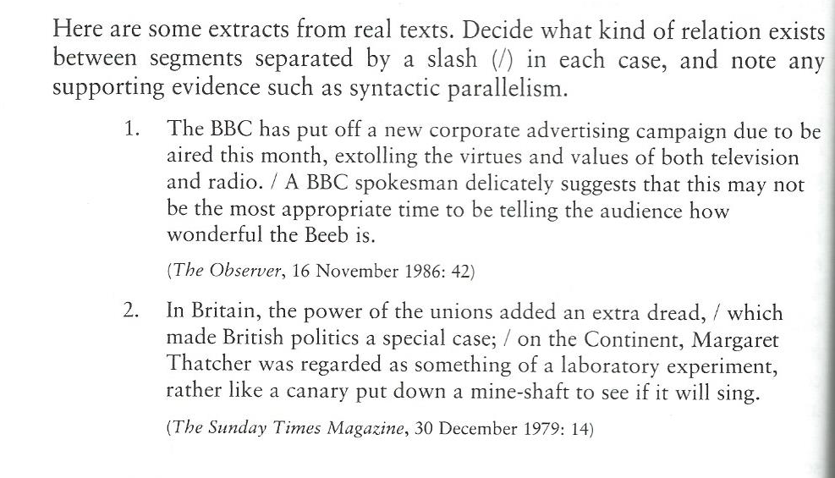
1- Second sentence is reason for the 1° (PHENOMENON-REASON)
2- CAUSE –CONSEQUENCE (first two segments, subordination as supporting evidence). First 2 segments taken together as one single segment are in contrast with the rest. Note the signal provided by the syntactic parallelism…

Slide 31
DA & GRAMMAR
Spoken and written discourse show grammatical connexions between individual clauses and sentences.
3 types of grammatical links or cohesive devices:
REFERENCE
ELLIPSIS/SUBSTITUTION
CONJUNCTION

Slide 32
DA & GRAMMAR
REFERENCE
Links or cohesive devices: Pronouns, demonstratives, determiner the and expressions like such a.
(for a complete list, cfr. Halliday and Hasan, 1976: 37-9)
Anaphoric reference: looks back in the text
Exophoric reference: refers to the world outside the text (not truly cohesive, because its is not text-internal, but part of the reader’s active role in creating coherence)
Cataphoric reference: we have to read on to understand the relation between the items and the referents (engaging the reader’s attention)

Slide 33
DA & GRAMMAR
1. A ANAPHORIC REFERENCE
Problems with ‘it’ and ‘this’ ‘that’
Also in other languages we may have problems with some cohesive items (‘sua’ in Italian, her? Your?; ‘lei’ , you?, she?)
These items can be used when an entity has already been marked as the focus of attention, using by using a deictic word: a, the, my, this, that…

Slide 34
DA & GRAMMAR
ANAPHORIC REFERENCE
«Analyzing where a business stands in relation to its market and competition, enables it to identify potential opportunities for growth and potential threats. It is then possible to set strategic objectives and to predict the human financial resources needed to achieve them» (Intelligent Business, Intermediate, Longman: 23)
«Globalisation is forcing businesseds to make cost savings by reducing operating costs. One way to do this is by outsorcing…» » (Intelligent Business, Intermediate, Longman: 58)
“Germany's Angela Merkel has restated her support for Jean-Claude Juncker to take over as president of the European Commission, at a mini-summit in Sweden. The chancellor said that while she was "happy" to say she wanted Mr Juncker for the top job, it was not "the main topic" of the two-day talks.” (BBC news, 10 June 2014)

Slide 35
DA & GRAMMAR
1.b EXOPHORIC REFERENCE
Related to the immediate context. Reference to a world shared by both sender and receiver.
«Leave it on the table»
The Pope, the PM, the Queen.
Problems with L2 students:
«Do you like the classical music?» (music being heard)
«Do you like classical music?» (are you fond of that type of music?)
“The secure video conference room in the basement of the West Wing fell silent. Next to me, Secretary Bob Gates sat in his shirtsleeves with his arms folded and his eyes fixed intently on the screen. The image was fuzzy, but unmistakable. One of the two Black Hawk helicopters had clipped the top of the stone wall surrounding the compound and crashed to the ground. Our worst fears were coming true..”(The Times, 10 June 2014)

Slide 36
DA & GRAMMAR
1.C CATAPHORIC REFERENCE
Related to referents to come, to be mentioned later. Reader’s attention hooked.
The untold message is: «Read on and find out more».
«It has often been compared to New Orlean’s Mardi Gras as an outdoor celebration. Certainly New York’s Mulberry Street and surrounding block have been as crowded over the last few days as Royal and Bourbon Streets in the French Quarter are for the Mardi Gras. More than three million people are estimated to have celebrated the 61° annual Feast of the San Gennaro down in Greenwich Village since it began on Thursday».
(The Guardian, 15 September 1987, quoted by McCarthy M. 1991: 42)

Slide 37
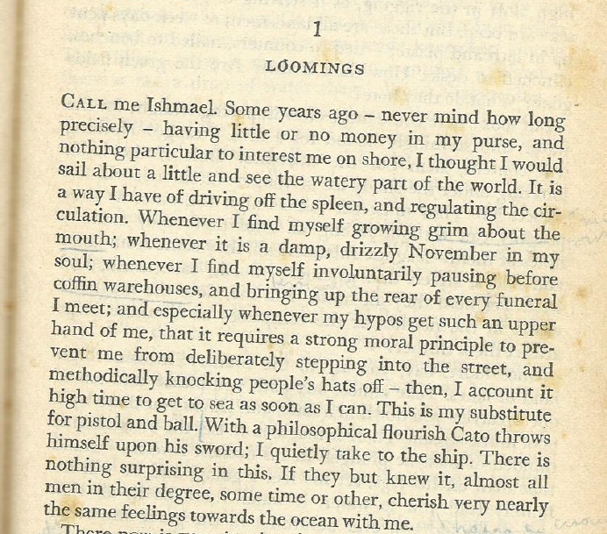
DA & GRAMMAR – Cohesive devices (reference)

Slide 38
DA & GRAMMAR – Cohesive devices
2. Ellipsis and Substitution
Ellipsis: Omission of elements. Speaker/writer choice made on a pragmatic assessment of the situation.
«The children will carry the small boxes, the adult the large ones»
(anaphoric);
«If you could, I’d like you to be back here at 5.30»
(cataphoric, but usually in front-placed subordinate clauses);
Verbal ellipsis, more complex:
A: Will anyone be waiting? B: Bill will, I think (auxiliary echoing ellipsis)
A: Has she remarried? B: No, but she will one day, I’m sure (auxiliary contrasting)

Slide 39
DA & GRAMMAR – Cohesive devices
2. Ellipsis and Substitution
Whole stretches of clauses may be omitted:
«Matteo Renzi said he would add 80 euros to some salaries as soon as he could, and he has»
Substitution is similar to ellipsis as it operates wither at the nominal, verbal or clausal level.
- One(s). I offered hima an ice cream. He said he didn’t want one.
- Do: Why don’t you find another boyfriend? I might do that.
-So/not: Do you need a lift? If so, wait for me, if not, I’ll see you there.
- Same: He chose the beef, I chose the same (I did the same)

Slide 40
DA & GRAMMAR – Cohesive devices
3. Conjunction
A conjuction presupposes a textual sequens, and signals a relationship between segments of the discourse.
Type Sub-types Examples
Elaboration apposition In other words
clarification or rather
Extension addition (adversative) and/but
variation alternatively
Ehancement spatio-temporal there/previously
causal-conditional consequently/in that case
(Halliday 1935: 306)

